Slide 1

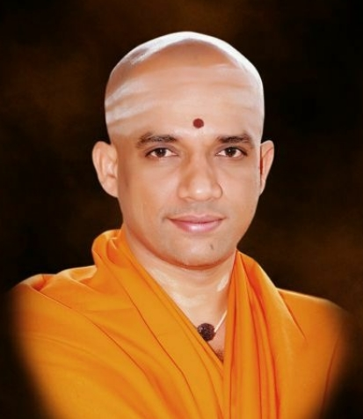



Department of COMPUtER Science and Engineering
“Loan prediction using AI&ML”
By
Gavi Shekhar [1JB21CS405]

Slide 2
OVERVIEW
About the Company
About the department
Task performed
Problem Statement
Methodology
Implementation
Conclusion
Dept of CSE, SJBIT
1

Slide 3
TaskS performed
Data collection
Data preprocessing
Model selection
Model training
Model evaluation
Deployment and monitoring

Slide 4
PROBLEM STATEMENT
Intensive time Consumption process of verification and validation. Human errors can be introduced during the validation process—no cross-referencing previous loan records.
A lot of human resources are required.
Dept of CSE, SJBIT
4

Slide 5
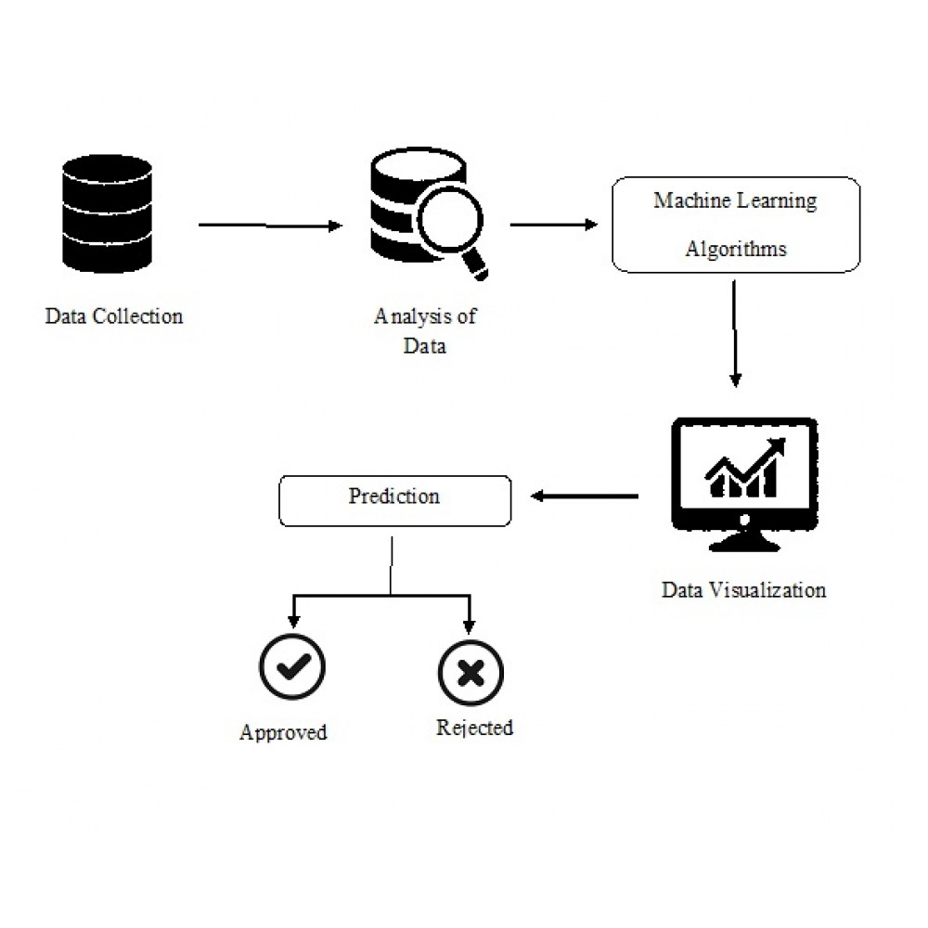



METHODOLOGY
Accuracy
Loan Amount
Dept of CSE, SJBIT
5

Slide 6
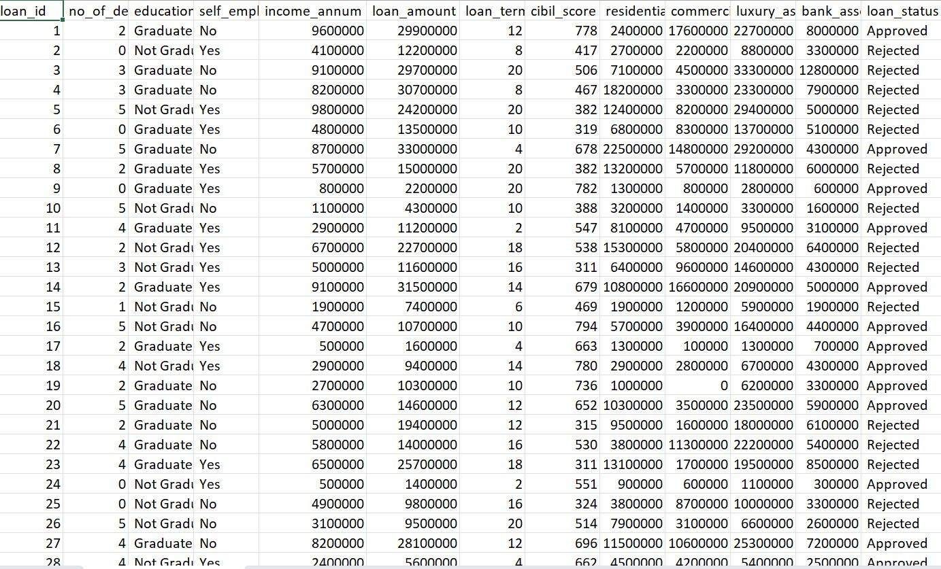
IMPLEMENTATION AND SNAPSHOTS
Fig: Dataset
Dept of CSE, SJBIT
7

Slide 7
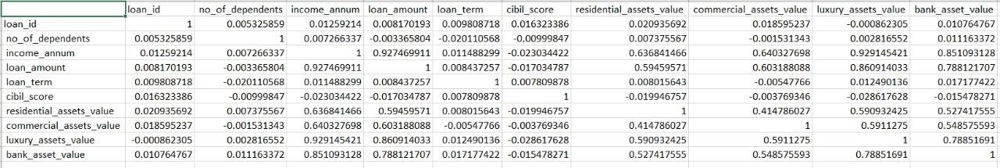
IMPLEMENTATION AND SNAPSHOTS
Fig: generated correlation excel file
Dept of CSE, SJBIT
7

Slide 8
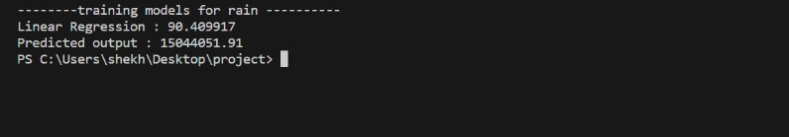
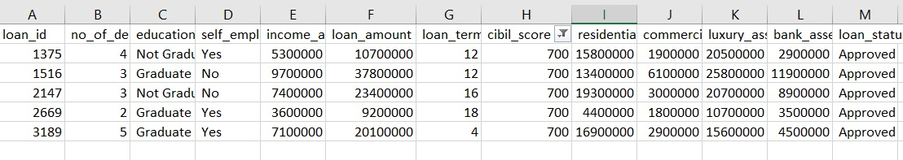
IMPLEMENTATION AND SNAPSHOTS
Fig: Loan predicted amount
Fig: Approval Status

Slide 9
Reflection notes
Project Contributions: Reflect on the specific projects you worked on during the internship, Consider your role, responsibilities, and the impact of your contributions.
Learning and Skill Development: Reflect on the new ML techniques, tools, and technologies you learned during the internship. Consider how these skills have enhanced your overall proficiency in machine learning.
Team Collaboration: Reflect on your interactions with team members and colleagues, Consider the effectiveness of communication, and collaboration, and how well you integrated into the team.
Problem-Solving Skills: Reflect on the challenges you encountered during the internship, Consider how you approached problem-solving, the strategies you used, and what you learned from overcoming obstacles.

Slide 10
THANK YOU

